Slide 2
Integrated University Department Information System
Team B6

Slide 3
The Software
Integrated University Department Information System
Solution to a Disembodied University
Aggregate Department’s Finances using a Tallying System
Conducts Minute Operations that interconnects Department to the larger University System

Slide 4
The Team
NYU SOE CS-UY-4523 Team B6
Project Manager/Advisor
Professor Fred Strauss
Majors: Computer Science, BS
Munieshwar “Kevin” Ramdass
Programmer, Author, Reviewer
Coordinator (April)
Ajay Shenoy
Programmer, Author, Reviewer
Coordinator (March)
August Tan
Programmer, Author, Reviewer
Coordinator (February)

Slide 5
Overview
Problem
Status Quo
Observations
Scenario
Requirements
Insight – Requirements
Opportunity – Analysis
Analogy
Solution
Design
Advantage
Future Work
Summary
Post Implementation Review
Questions/Answers
Demonstration

Slide 6
Status Quo
Traditional Organizations
Separate Information System
Separate Bursar System
Universities
Separate Registrar System
Separate Bursar System
← Focus for the IUDIS

Slide 7
Observations
Issues with the Traditional Set Up:
Slow
Systems might not necessarily share the same database
Updates must be done separately
Inefficient/Inconsistent
An update to one system requires an update to the other
Confusing
Information might be different on separate systems

Slide 8
Scenario
Munieshwar’s Information in NYU’s Traditional System:
NYU’s Registrar – Albert (Technically the main system)
Official Name: Munieshwar Ramdass
Public Name: Munieshwar (Kevin) Ramdass ← Rarely Seen
Kevin Ramdass ← Usually the case on Roster
Financial Info: Not current/updated/live
NYU’s Bursar (Technically the separated system)
Official Name: Munieshwar Ramdass
Public Name: Munieshwar Ramdass
Financial Info: Current/updated/live

Slide 9
Insight – Requirements
Despite the previous slides
Diploma might read: “Munieshwar” “Kevin” Ramdass
Ramdass “Kevin” “Munieshwar”
Due to Registrar confusion
NYU Bursar has less flaws (in our opinion)
Should a system be designed/built, it should be like the Bursar
It should also include registrar functionality

Slide 10
Opportunity – Analysis
Opportunity: Combine Systems
Registrar
Bursar
Make the IUDIS
Enable use for all users: Students, Professors, and Officials
Have one system take care of everything under a single database
All departments and university systems will have the same info
Departments will share information throughout the school as one

Slide 11
Opportunity – Analysis
Registrar
Pros:
Has most of user’s information
Both accurate and inaccurate
Cons:
No live financial information
Poor inaccurate info management
Used too frequently for ID
Bursar
Pros:
Live financial information
Better for user ID
Cons:
Only minimal info provided

Slide 12
Analogy
Most organizations use the traditional disembodied system
Closest Analogy: Amazon’s website
User can enter information about his/her self
User can enter information about his business (if seller)
User can add payment options to his/her account
User can make payments and run his/her business on one web app
User can be a regular buyer

Slide 13
Solution – Design
1. Administrators/Officials must be able to create/modify/delete/view class.
2. Administrators/Officials must be able to create/modify/delete/view any user account.
3. There must be a way to update a student’s transcript and disclose them to the appropriate student.
4. Officials from university system must be able to handle all expenses.
5. There must be a payable and receivable system.
6. The use of the integrated university’s emailing and mailing system will be used.
7. Administrators must have access to entire IUDIS and its database.
8. There must be a way for users to login and logout.

Slide 14
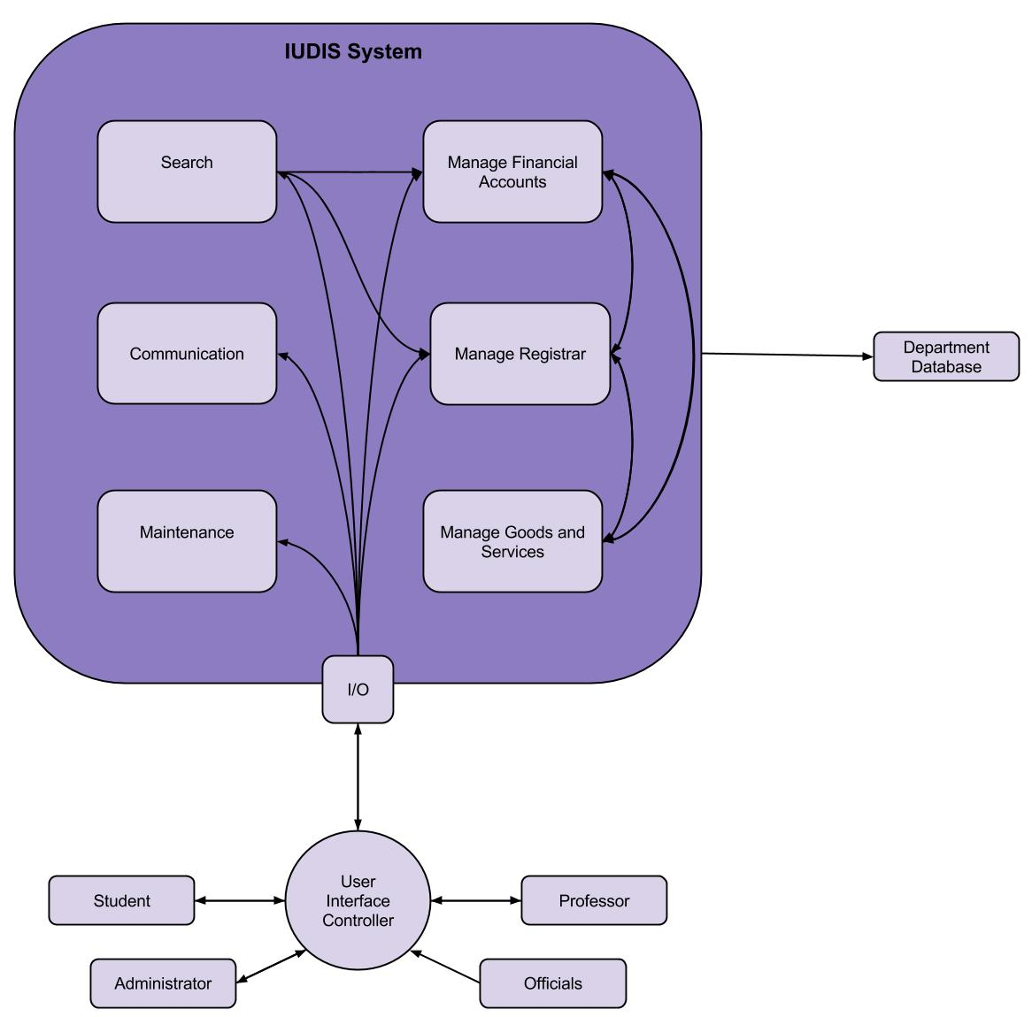
Solution – Design
Component Architecture
RAS Section 6.3.2

Slide 15
Advantage
One system to manage
Fast access to all user information
Easy update for all information
Efficient and consistent updates
No information differences from disembodied system
No confusion from separate systems

Slide 16
Future Work
Given more time:
Implement the rest of the use cases
Beautify the interface as it was a requirement
Add a higher level of security
Combining the Registrar and Bursar may introduce security risks
Gaining access by illegal means allows attacker to read all information
Makes work easier for attacker
Otherwise, information would be separated in the traditional model

Slide 17
Post Implementation Review
Right
Management Plan
Design
Wrong
Did not follow the plan entirely
Distribution of work (not democratic)
Members are not familiar with each other’s progressions
Possible Changes
Work on a single computer for everything with all members present

Slide 18
Questions?

Slide 19
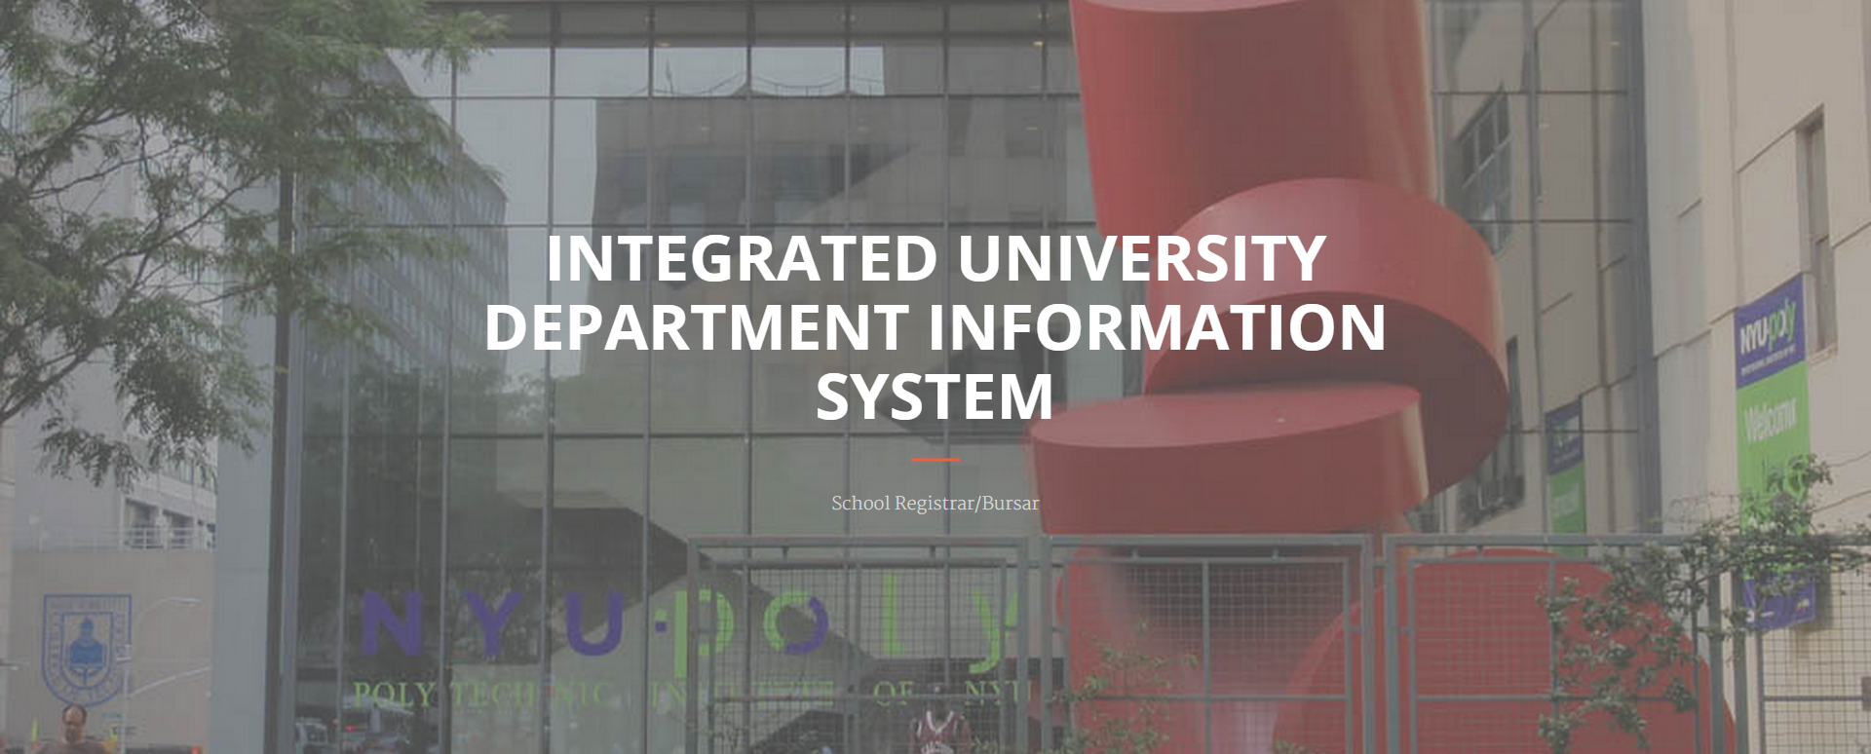
Demonstration
Refer to Demo Screen

Slide 20
Integrated University Department Information System
Team B6

